Slide 1
Palette
Project CREDO
Customizable, REproducible,
Dockerfile Generator for Bioinformatics Applications.
Luca Alessandrì – Eliseo Martelli

Slide 2
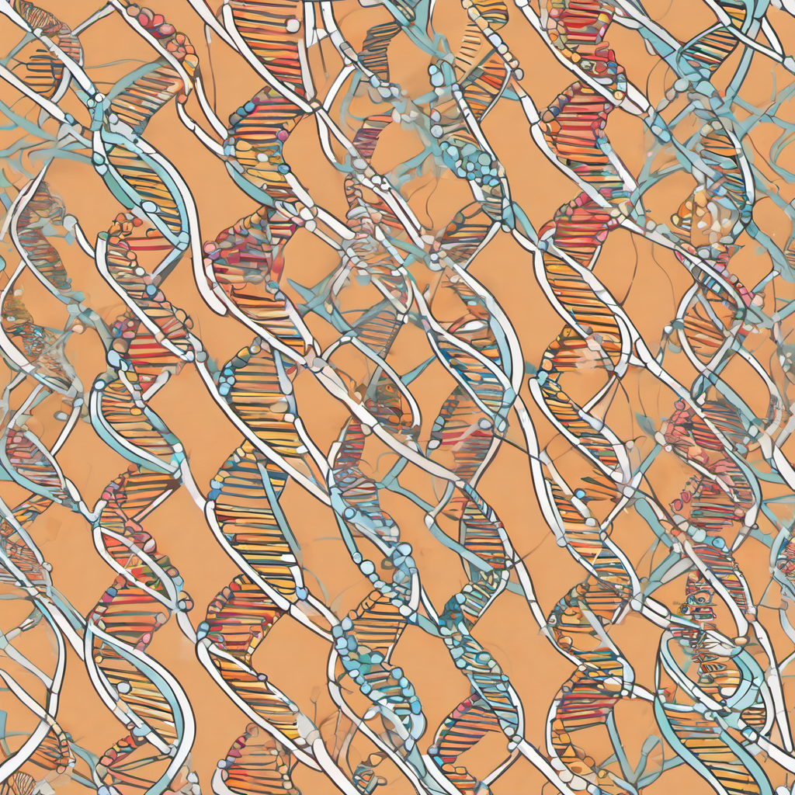
Bioinformatics is a discipline
that intersects various
fields of research.

Slide 3
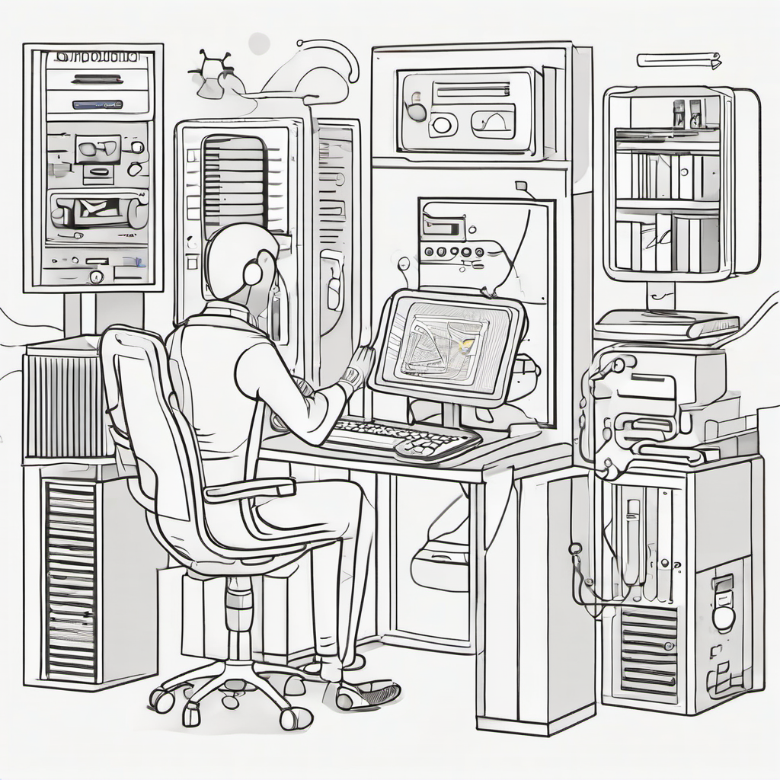
Bioinformatics is a discipline
that intersects various
fields of research.
Biology
Computer Science
Statistics

Slide 4

Bioinformatics is a discipline
that intersects various
fields of research.
Biology
Computer Science
Statistics

Slide 5
Bioinformatics is a discipline
that intersects various
fields of research.
Biology
Computer Science
Statistics

Slide 6
PROBLEM
Experiment Reproducibility
is hard in Bioinformatics.

Slide 7
PROBLEM
Validity & Reliability
Experiment Reproducibility
is hard in Bioinformatics.
Insufficient Documentation
Lack of Standardization

Slide 8
PROBLEM
Validity & Reliability
Experiment Reproducibility
is hard in Bioinformatics.
Insufficient Documentation
Lack of Standardization

Slide 9
PROBLEM
Experiment Reproducibility
is hard in Bioinformatics.
Validity & Reliability
Insufficient Documentation
Lack of Standardization

Slide 10
Docker emerged as a possible solution
to solve problems in this context.
But doesn’t solve the issue of dependency pinning.

Slide 11
CREDO aims to enhance reproducibility
in bioinformatics analysis.

Slide 12
Captures a temporary environment
Currently, CREDO
employs a three-step process.
Generates a build script
Packages the dependencies

Slide 13
Captures a temporary environment
Currently, CREDO
employs a three-step process.
Generates a build script
Packages the dependencies

Slide 14
Currently, CREDO
employs a three-step process.
Captures a temporary environment
Generates a build script
Packages the dependencies

Slide 15
FAIR Principles
CREDO stands by the
F

Slide 16
F
FINDABILITY
CREDO stands by the
FAIR Principles
Consolidation of sources for researchers
to access, install, and utilize the software using centralized platforms.
A

Slide 17
F
A
ACCESSIBILITY
FAIR Principles
Simplification of the process of creating
reproducible environments to users without
previous bioinformatics knowledge.
I

Slide 18
A
I
INTEROPERABILITY
FAIR Principles
Ensuring compatible with the most widely available operating systems to maximize the range of users that can use the application.
R

Slide 19
I
R
REUSABILITY
FAIR Principles
Facilitation of software customization.
Ensure archival of dependencies to prevent
future inaccessibility of dependencies.

Slide 20
R
NOW
CREDO exists only as a proof-of-concept.
The Plan

Slide 21
Modularity & Optimization
UI Redesign
Multiuser Environment
DOI Tagging
Quality Assurance & Testing
Documentation
Achieved through code-refactoring and implementing strong architectural patterns.
Improve UI design and performance to increase user interaction quality and speed.
Restructure the application to support multiple users and permissions.
Assign DOI references to artifacts generated
to facilitate citations and references.
Configure safeguards and robust testing methodologies via CI and GitOps.
Produce In-depth documentation by following a doc-first approach.
NOW
CREDO exists only as a proof-of-concept.
The Plan

Slide 22
The Plan
Modularity & Optimization
UI Redesign
Multiuser Environment
DOI Tagging
Quality Assurance & Testing
Documentation
Achieved through code-refactoring and implementing strong architectural patterns.
Improve UI design and performance to increase user interaction quality and speed.
Restructure the application to support multiple users and permissions.
Assign DOI references to artifacts generated
to facilitate citations and references.
Configure safeguards and robust testing methodologies via CI and GitOps.
Produce In-depth documentation by following a doc-first approach.

Slide 23
The Plan
Modularity & Optimization
UI Redesign
Multiuser Environment
DOI Tagging
Quality Assurance & Testing
Documentation
Achieved through code-refactoring and implementing strong architectural patterns.
Improve UI design and performance to increase user interaction quality and speed.
Restructure the application to support multiple users and permissions.
Assign DOI references to artifacts generated
to facilitate citations and references.
Configure safeguards and robust testing methodologies via CI and GitOps.
Produce In-depth documentation by following a doc-first approach.

Slide 24
The Plan
Modularity & Optimization
UI Redesign
Multiuser Environment
DOI Tagging
Quality Assurance & Testing
Documentation
Achieved through code-refactoring and implementing strong architectural patterns.
Improve UI design and performance to increase user interaction quality and speed.
Restructure the application to support multiple users and permissions.
Assign DOI references to artifacts generated
to facilitate citations and references.
Configure safeguards and robust testing methodologies via CI and GitOps.
Produce In-depth documentation by following a doc-first approach.

Slide 25
The Plan
Modularity & Optimization
UI Redesign
Multiuser Environment
DOI Tagging
Quality Assurance & Testing
Documentation
Achieved through code-refactoring and implementing strong architectural patterns.
Improve UI design and performance to increase user interaction quality and speed.
Restructure the application to support multiple users and permissions.
Assign DOI references to artifacts generated
to facilitate citations and references.
Configure safeguards and robust testing methodologies via CI and GitOps.
Produce In-depth documentation by following a doc-first approach.

Slide 26
The Plan
Modularity & Optimization
UI Redesign
Multiuser Environment
DOI Tagging
Quality Assurance & Testing
Documentation
Achieved through code-refactoring and implementing strong architectural patterns.
Improve UI design and performance to increase user interaction quality and speed.
Restructure the application to support multiple users and permissions.
Assign DOI references to artifacts generated
to facilitate citations and references.
Configure safeguards and robust testing methodologies via CI and GitOps.
Produce In-depth documentation by following a doc-first approach.

Slide 27
The Plan
Modularity & Optimization
UI Redesign
Multiuser Environment
DOI Tagging
Quality Assurance & Testing
Documentation
Achieved through code-refactoring and implementing strong architectural patterns.
Improve UI design and performance to increase user interaction quality and speed.
Restructure the application to support multiple users and permissions.
Assign DOI references to artifacts generated
to facilitate citations and references.
Configure safeguards and robust testing methodologies via CI and GitOps.
Produce In-depth documentation by following a doc-first approach.

Slide 28
Callout.
The Plan
subtitle
Modularity & Optimization
UI Redesign
Multiuser Environment
DOI Tagging
Quality Assurance & Testing
Documentation
Achieved through code-refactoring and implementing strong architectural patterns.
Improve UI design and performance to increase user interaction quality and speed.
Restructure the application to support multiple users and permissions.
Assign DOI references to artifacts generated
to facilitate citations and references.
Configure safeguards and robust testing methodologies via CI and GitOps.
Produce In-depth documentation by following a doc-first approach.

